Slide 1

QuickBite
School of Future Tech
CASE STUDY 83 · DATABASE MANAGEMENT SYSTEMS
Food Delivery Order & Restaurant Management System — a relational database built with PostgreSQL
Aditya Sunil Chouksey
150096725070 · B.Tech Computer Science Engineering
Notes:
[about 30 seconds] Good morning everyone. I'm Aditya Sunil Chouksey, and my case study is number 83: QuickBite, a food delivery order and restaurant management system. QuickBite is an aggregator, like Swiggy or Zomato. It lists restaurant menus and processes customer orders. In the next few minutes I'll cover the problem, the ER diagram, how I normalized the schema, the key queries, the index I built, and how the database protects its own data. Everything I show was run on a real PostgreSQL 18 database.

Slide 2




The problem
INTRO
QuickBite lists restaurant menus and processes customer orders. It needs one database that tracks revenue per restaurant and surfaces each restaurant's most popular dish for promotion.
Revenue per restaurant
Most popular dish
Fast search
Valid orders only
Browse restaurants by cuisine and area
Every order has a real customer, restaurant and agent
Total earned from delivered orders
Top dish of each restaurant, ties included
Composite index
GROUP BY + SUM
JOIN + COUNT + subquery
FKs + trigger
QuickBite · Case Study 83 · 02
Notes:
[about 45 seconds] The problem. QuickBite lists restaurant menus and takes customer orders, and the business needs two answers from its data: how much revenue each restaurant earns, and which dish is each restaurant's most popular, so it can be promoted. From the brief I took four goals. One: revenue per restaurant, which is a GROUP BY with SUM. Two: the most popular dish, using a JOIN, COUNT and a ranking subquery. Three: fast search, because browsing by cuisine and area is the app's most common search, so I added a composite index. Four: valid data. Every order must belong to a real customer, restaurant and delivery agent. I'll show how each of these is met.

Slide 3
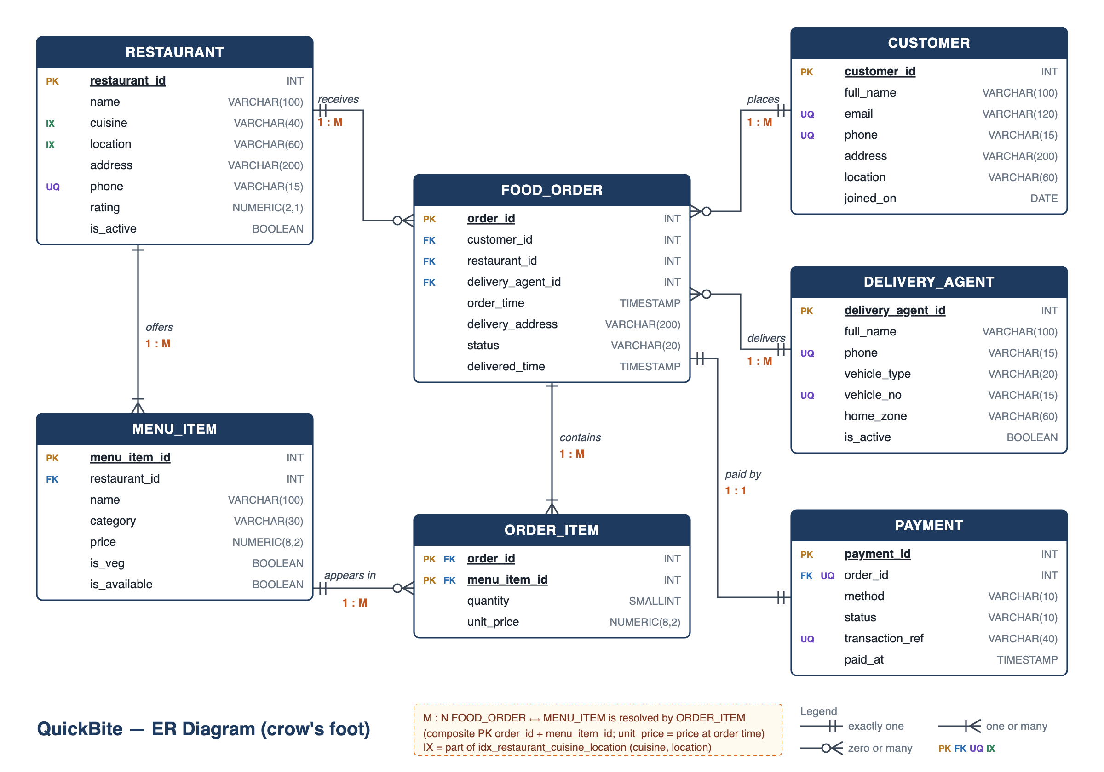
ER diagram
DESIGN
7 entities, crow's-foot notation
1 : M
Restaurant offers MenuItems
1 : M
Customer, Restaurant and DeliveryAgent each link to many FoodOrders
M : N
FoodOrder and MenuItem, through ORDER_ITEM
1 : 1
FoodOrder has one Payment (FK + UNIQUE)
QuickBite · Case Study 83 · 03
Notes:
[about 90 seconds: your explanation] Suggested order: start at the centre, then go outward. 1. FOOD_ORDER is the centre. It holds order_id, customer_id, restaurant_id, delivery_agent_id and order_time, the fields the brief asks for. 2. Point left-up to RESTAURANT: one restaurant receives many orders (1:M). The circle on the order end means a restaurant can have zero orders, like Malvani Tadka. 3. Right side: CUSTOMER places many orders, DELIVERY_AGENT delivers many orders. Both 1:M. The two bars on the parent end mean exactly one: every order has exactly one customer and one agent. 4. RESTAURANT down to MENU_ITEM: one restaurant offers many dishes (1:M). 5. The M:N: one order has many dishes and one dish is in many orders. A relational table can't store that directly, so ORDER_ITEM sits in the middle, with a composite primary key (order_id + menu_item_id). It also stores quantity and unit_price, the price at the time of the order. 6. PAYMENT is 1:1 with FOOD_ORDER. That comes from a foreign key that is also UNIQUE. 7. The tags: PK = primary key, FK = foreign key, UQ = unique, IX = part of the search index on cuisine and location.

Slide 4

Normalization
DESIGN
After: two linked tables
Before: one flat sheet
restaurant
Cuisine and area repeated on every dish row
id | name | cuisine | area
1 | Punjab Da Dhaba | North Indian | Kharghar
restaurant | cuisine | area | dish
Punjab Da Dhaba | North Indian | Kharghar | Butter Chicken
Punjab Da Dhaba | North Indian | Kharghar | Dal Makhani
Punjab Da Dhaba | North Indian | Kharghar | Paneer Tikka
menu_item
id | restaurant_id (FK) | dish
1 | 1 | Butter Chicken
2 | 1 | Dal Makhani
3 | 1 | Paneer Tikka
2NF: partial dependency on the key removed
3NF: order totals calculated by a view, not stored
BCNF: every determinant is a candidate key
QuickBite · Case Study 83 · 04
Notes:
[about 60 seconds] The brief points out a redundancy: the restaurant's cuisine and address were repeated on every menu-item row. On the left you can see Punjab Da Dhaba, North Indian, Kharghar, written three times. The key of that sheet is restaurant plus dish, but cuisine and address depend on the restaurant alone, which is only part of the key. That's a partial dependency, so the sheet breaks second normal form. It causes update, insert and delete anomalies: if the restaurant moves, every row must change. The fix, on the right: restaurant details are stored once in a restaurant table, and menu_item points to it with a foreign key. That gives 2NF. For 3NF, I don't store order totals. A view calculates them, so they can never go out of date. Finally, in every table, everything that determines another column is a candidate key, so the schema is in BCNF. If asked: unit_price in order_item is not redundancy. It's the price at the time of the order, so old bills stay correct when menu prices change.

Slide 5
Key queries
RESULTS
Most popular dish per restaurant
Revenue per restaurant
JOIN · GROUP BY · COUNT · ranking subquery
LEFT JOIN · GROUP BY · SUM
restaurant | dish | orders
Punjab Da Dhaba | Butter Chicken | 6
Biryani Darbar | Chicken Dum Biryani | 5
Udupi Sagar | Masala Dosa | 4
Dragon Wok | Chilli Paneer | 3 · tie
Dragon Wok | Veg Hakka Noodles | 3 · tie
restaurant | delivered | revenue
Biryani Darbar | 6 | ₹5,270
La Pizzeria Napoli | 5 | ₹4,447
Punjab Da Dhaba | 6 | ₹4,330
… | … | …
Malvani Tadka | 0 | ₹0
5 of 11 rows shown. Both tied dishes are kept.
LEFT JOIN keeps a restaurant with no orders, at ₹0.
Cancelled orders are excluded everywhere. Revenue counts delivered orders only. All 10 queries and their outputs are in sql/04_queries.sql.
QuickBite · Case Study 83 · 05
Notes:
[about 60 seconds] These are the two queries the brief asks for, with real output. Left: the most popular dish for each restaurant. I JOIN the order lines with the menu items, GROUP BY restaurant and dish, and COUNT how many orders contain each dish. Then a ranking subquery in HAVING keeps only the dish whose count equals that restaurant's highest count. The subquery is correlated: it runs once for each restaurant. Butter Chicken wins at Punjab Da Dhaba with 6 orders. Look at Dragon Wok: two dishes tie at 3, and the query keeps both. I put that tie in the sample data on purpose, to prove the query handles ties. Right: revenue per restaurant. A GROUP BY with SUM over the order totals, delivered orders only. Biryani Darbar earns the most, at 5,270 rupees. I used a LEFT JOIN, so Malvani Tadka, which has no orders yet, still appears with zero instead of disappearing.

Slide 6

Indexing
RESULTS
CREATE INDEX idx_restaurant_cuisine_location ON restaurant (cuisine, location);
WITHOUT INDEX
13.42 ms
WITH INDEX
1.05 ms
~13× faster
Bitmap Index Scan: reads 835 matches
Seq Scan: reads all 200,011 rows
Tested on 200,000 synthetic restaurants inside a transaction, then rolled back. Column order matters: the index also speeds up cuisine-only searches (leftmost prefix).
QuickBite · Case Study 83 · 06
Notes:
[about 50 seconds] The advanced concept is indexing. Browsing restaurants by cuisine and area is the app's most common search, so I created a composite B-tree index on cuisine and location. To prove it works, I loaded 200,000 test restaurants inside a transaction and ran the same search, "North Indian in Kharghar", with EXPLAIN ANALYZE. Without the index, PostgreSQL does a sequential scan and reads every row: about 13 milliseconds. With the index, it does a bitmap index scan and reads only the 835 matching rows: about 1 millisecond, roughly 13 times faster. Then I rolled the transaction back, so the test rows never touched the real data. The column order matters. Cuisine comes first, so the same index also speeds up cuisine-only searches. That's the leftmost-prefix rule. If asked: the exact milliseconds change on every run, but the plan change from Seq Scan to Index Scan is always the same. On a tiny 11-row table, PostgreSQL correctly skips the index, because one page read is cheaper.

Slide 7
All four outcomes met and verified
CONCLUSION
Delivered
Next steps
7 tables in BCNF, with a full ER diagram
Most popular dish and revenue per restaurant
Index: ~13× faster at 200,000 rows
9 / 9 invalid writes rejected
Partition orders by month
Materialized view for revenue reports
Lookup tables for cuisine and area
Distance-based search with PostGIS
Thank you – questions?
QuickBite · Case Study 83 · 07
Notes:
[about 45 seconds] To conclude: all four outcomes from the brief are met, and each one was verified on a live database. Delivered: a schema of 7 tables in BCNF, with a full ER diagram. The two required queries, most popular dish and revenue per restaurant. The composite index, which made the cuisine-and-area search about 13 times faster on 200,000 rows. And integrity: I tried nine invalid writes, such as an order for a customer that doesn't exist, a biryani on a pizza order, or a second payment for one order. All nine were rejected by the database itself, through foreign keys, NOT NULL, the trigger, RESTRICT, UNIQUE and CHECK. Next steps, if QuickBite grew: partition the orders table by month, turn the order-total view into a materialized view for faster revenue reports, move cuisine and area into lookup tables so spellings stay consistent, and add real distance-based search with PostGIS. Everything is in my GitHub repository. Thank you, and I'm happy to take questions.

